Slide 1
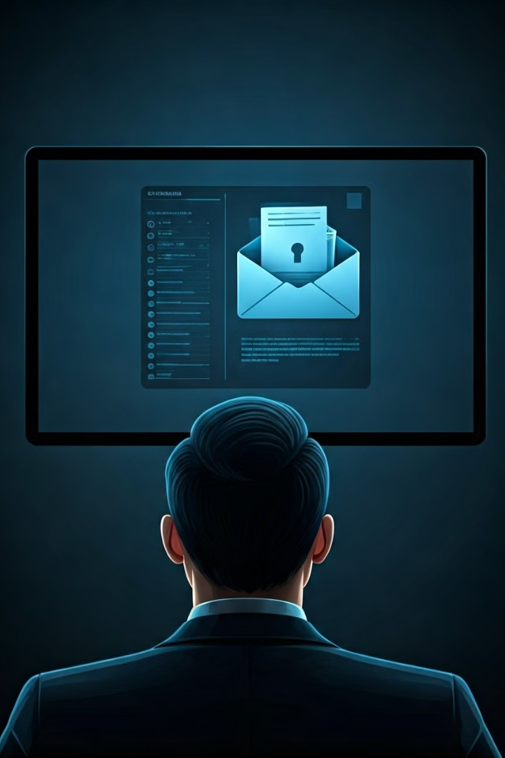
Introduction to Phishing Attacks
Phishing attacks are a common type of cybercrime that targets individuals and organizations by attempting to steal sensitive information such as usernames, passwords, credit card details, or bank account information. Phishers often use deceptive emails, websites, or social engineering tactics to trick victims into divulging their personal data. This presentation will guide you through understanding phishing attacks, recognizing phishing attempts, and implementing best practices to safeguard yourself and your organization.

Slide 2
Understanding Phishing Tactics
Email Phishing
Website Phishing
Social Engineering
This is the most common type of phishing attack. Phishers send emails that appear to be from legitimate sources, like banks, social media platforms, or government agencies, often with urgent or enticing subject lines. They may include malicious links that lead to fake websites or attachments containing malware.
Phishers create fake websites that look identical to legitimate ones, such as online banking portals or shopping sites. These sites are designed to collect sensitive data like login credentials, credit card information, or personal details.
Phishers use psychological manipulation to trick victims into revealing sensitive information. This could involve posing as a trusted source, using social pressure, or creating a sense of urgency to compel victims to comply with their requests.

Slide 3

Recognizing Phishing Emails
1
Check the Sender's Address
2
Be Wary of Urgent Messages
Pay close attention to the sender's email address. Phishers may use addresses that look similar to legitimate ones but have subtle differences. For example, a fake bank email might use "bankofamerica.com" instead of the correct "bankofamerica.com."
Phishers often try to create a sense of urgency, urging you to act immediately. This might involve threats, warnings, or offers that are too good to be true. Don't be pressured into clicking links or providing information without careful consideration.
3
Inspect Links Before Clicking
4
Watch Out for Spelling Errors
Hover your mouse over any links in the email before clicking them. The actual URL displayed in the status bar should match the text of the link. If they differ, it could be a phishing attempt.
Phishers often create emails in haste, resulting in spelling errors or grammatical mistakes. Pay attention to these details, as they can be a sign of a fraudulent email.

Slide 4
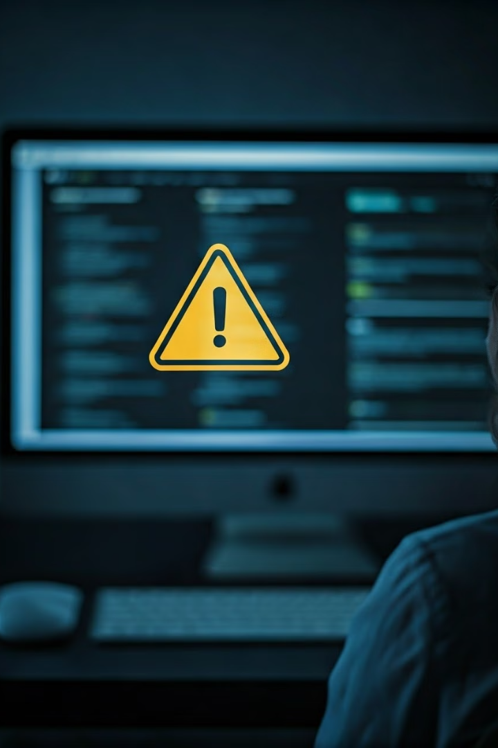
Identifying Malicious Websites
Check the URL
Look for SSL Certificates
Legitimate websites typically have secure URLs starting with "https://" and a padlock icon next to the website address in the browser. Pay close attention to the domain name and ensure it matches the intended website.
Secure websites use SSL certificates to encrypt data transmitted between your browser and the website. The padlock icon in the address bar indicates an active SSL certificate.
Examine Website Design
Beware of Pop-Up Windows
Phishing websites often have poor design, mismatched fonts, or awkward layouts. They may also contain grammatical errors or misspelled words. Trust your instincts – if something doesn’t feel right, it probably isn’t.
Many phishing websites use pop-up windows to trick users into providing personal information. If a website suddenly displays a pop-up requesting your details, be cautious and avoid submitting any data.

Slide 5




Protecting Against Social Engineering
Verify Information
If someone requests sensitive information, always verify their identity and the legitimacy of their request. Don't hesitate to contact the organization directly to confirm their identity and the purpose of the communication.
Be Skeptical of Unusual Requests
If you receive an unusual request, such as a phone call asking for your password or a message demanding immediate payment, be cautious. These could be social engineering tactics designed to exploit your trust.
Think Before You Click
Don't rush into clicking links or downloading files from unknown sources. Always take a moment to consider the source of the information and the potential consequences of your actions.

Slide 6
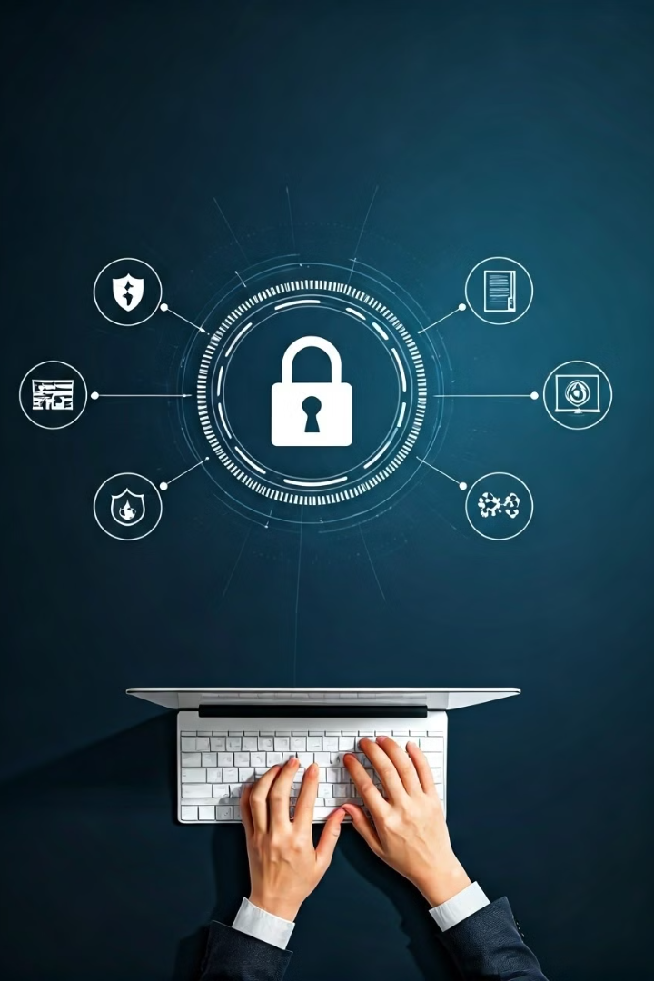
Best Practices for Avoiding Phishing
Strong Passwords
Use unique and complex passwords for all your online accounts, and avoid reusing passwords across multiple websites.
Multi-Factor Authentication
Enable multi-factor authentication (MFA) for all your accounts whenever possible. MFA requires you to provide an additional authentication factor, such as a code sent to your phone, in addition to your password, making it much harder for phishers to gain access to your accounts.
Keep Software Updated
Regularly update your operating system, web browser, and antivirus software to ensure that you have the latest security patches and bug fixes.
Be Cautious of Public Wi-Fi
Avoid using public Wi-Fi networks for sensitive online activities, such as banking or shopping. Public Wi-Fi is often less secure, making your data more vulnerable to interception by phishers.

Slide 7





Reporting and Responding to Phishing
Report Phishing Attempts
Change Your Passwords
If you encounter a phishing email, website, or social engineering attempt, report it to the relevant authorities. Most email providers and websites have reporting mechanisms for suspicious activities. You can also contact your local law enforcement agencies or cybersecurity organizations.
If you suspect you have been a victim of a phishing attack, immediately change your passwords for any accounts that may have been compromised. This helps prevent further unauthorized access to your accounts.
Scan Your Computer
Seek Help
Run a full scan of your computer with your antivirus software to detect and remove any malware that may have been downloaded during a phishing attack. This helps ensure that your device is free from malicious programs.
If you are unsure about how to respond to a phishing attack or if you have any concerns about your security, don’t hesitate to seek help from your IT department, cybersecurity experts, or a trusted source. They can provide guidance and support to help you stay protected.

Slide 8

Conclusion and Key Takeaways
1
Awareness is Key
Being aware of phishing tactics and taking necessary precautions is the best way to protect yourself. Familiarize yourself with common phishing methods, check for suspicious details in emails and websites, and practice caution when sharing personal information online.
2
Stay Vigilant
Phishing attacks are constantly evolving, so it's important to stay updated on the latest phishing trends and techniques. Regularly review security best practices and seek guidance from reputable sources to keep yourself ahead of the curve.
3
Report and Respond
If you encounter a phishing attempt, don't hesitate to report it. By reporting phishing attacks, you help to protect others and contribute to a safer online environment. Taking immediate action can help mitigate potential damage and prevent future attacks.

Slide 9

THANK YOU

